Slide 1


Kostas Tzoumas @kostas_tzoumas
Hadoop Summit San Jose
June 6, 2016
Streaming in the Wild with Apache FlinkTM

Slide 2
Streaming technology is enabling the obvious: continuous processing on data that is continuously produced
Hint: you are already doing streaming

Slide 3
Why embrace streaming?
Monitor your business and react in real time
Implement robust continuous applications
Adopt a decentralized architecture
Consolidate analytics infrastructure

Slide 4
React in real time

Slide 5
Streaming versus real-time
Streaming != Real-time
E.g., streaming that is not real time: continuous applications with large windows
E.g., real-time that is not streaming: very fast data warehousing queries
However: streaming applications can be fast
Streaming
Real time

Slide 6
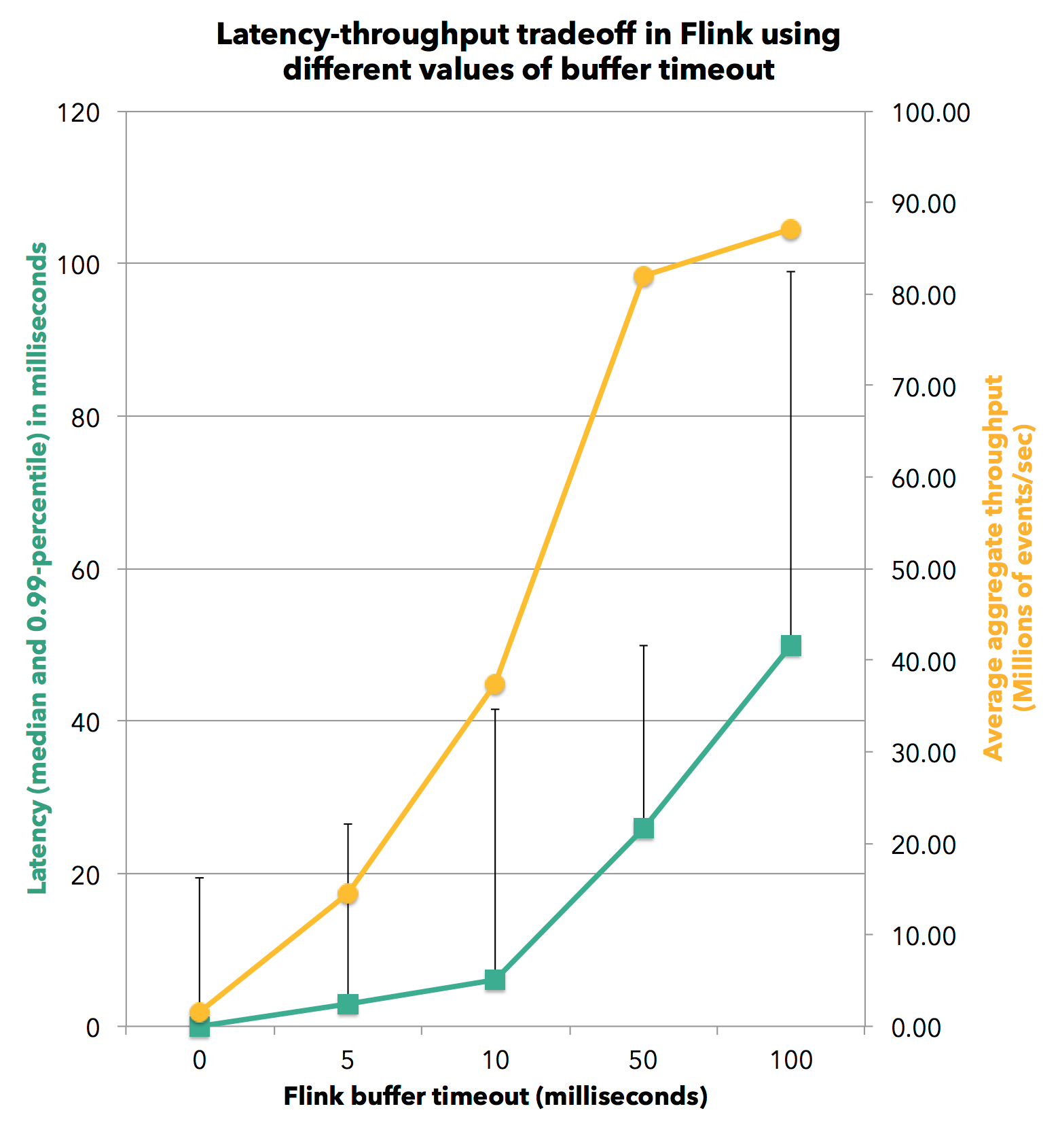
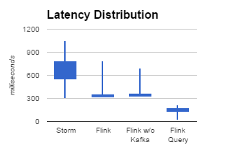
How real-time is Flink?
Yahoo! benchmark*
data Artisans benchmarks**
* https://yahooeng.tumblr.com/post/135321837876/benchmarking-streaming-computation-engines-at
** http://data-artisans.com/extending-the-yahoo-streaming-benchmark/ and http://data-artisans.com/high-throughput-low-latency-and-exactly-once-stream-processing-with-apache-flink/

Slide 7
When and why does this matter?
Immediate reaction to life
E.g., generate alerts on anomaly/pattern/special event
Avoid unnecessary tradeoffs
Even if application is not latency-critical
With Flink you do not pay a price for latency!

Slide 8
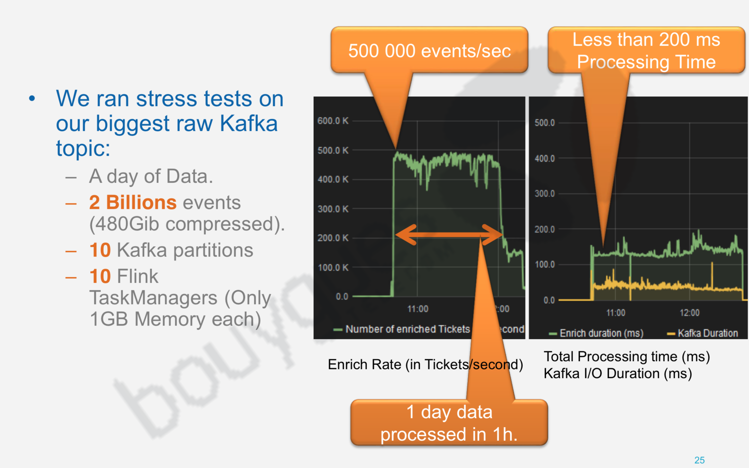
Bouygues Telecom – LUX
One of the largest telcos in France. System (among others) used for real time diagnostics and alarming.
Read more: http://data-artisans.com/flink-at-bouygues-html/

Slide 9
Robust continuous applications

Slide 10
Continuous application
A production data application that needs to be live 24/7 feeding other systems (perhaps customer-facing)
Need to be efficient, consistent, correct, and manageable
Stream processing is a great way to implement continuous applications robustly

Slide 11
Continuous apps with “batch”
Scheduler
file 1
Job 1
file 2
Job 2
Serve & store
file 3
Job 3
time

Slide 12
Continuous apps with “lambda”
Scheduler
file 1
Job 1
Serve & store
file 2
Job 2
Streaming job

Slide 13
Problems with batch and λ
Way too many moving parts (and code dup)
Implicit treatment of time
Out of order event handling
Implicit batch boundaries
Notes:
3 systems (batch), or 5 systems (streaming), Need to add a new system for millisecond alerts
What If I want to count every 5 minutes, not 1 hour?
Just ignores out of order
What if I wanna do sessions?

Slide 14
Continuous apps with streaming
Streaming job
Serve & store

Slide 15
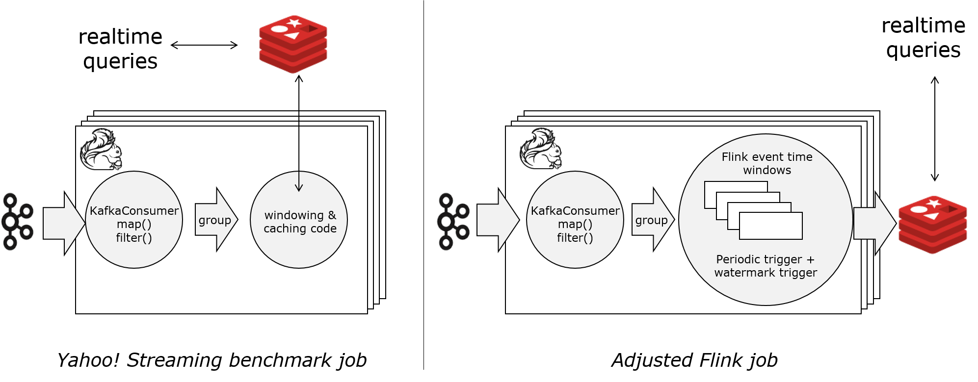
Extending the Yahoo! benchmark
Work of Jamie Grier, inspired by a real continuous application at Twitter
http://data-artisans.com/extending-the-yahoo-streaming-benchmark/

Slide 16
What is the use case?
Counting!
Tweet impressions or ad views
Most analytics is continuous counting and aggregations grouped by dimensions
E.g., anomaly detection

Slide 17
Requirements
Performance: millions of events/sec, millions of keys
Correctness: counts correlated with timestamps
Consistency: counts should be correct under failures
Manageability: ability to pause & restart, reprocess, change code, etc

Slide 18
Before Flink
Performance: 1000s of cores needed to sustain workload
Correctness: time handled in application code (or not)
Consistency: approximate results during the day, exact results once a day (lambda)
Manageability: acceptable

Slide 19
After Flink
Performance: 10s of cores needed to sustain workload
Correctness: time handled by framework
Consistency: correct results on demand
Manageability: acceptable

Slide 20
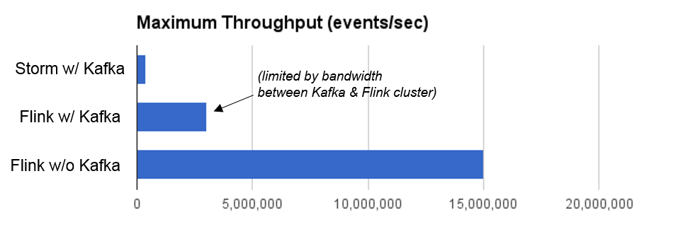
Results (yet to be beaten!)
Same program as Yahoo! benchmark
30x over Storm, plus consistent results

Slide 21
Manageability
Flink savepoints (Flink 1.0): consistent snapshots of stateful applications
Planned downtime for code upgrades, maintenance, migration, debugging, etc
Monitoring (Flink 1.1)
Dynamic scaling (Flink 1.2+)

Slide 22
Decentralized architecture

Slide 23
Streaming and microservices
local state
local state
A decentralized architecture favors a streaming-based data infrastructure with local application state
App
App
App
Archive

Slide 24

Zalando
Slides at http://www.slideshare.net/ZalandoTech/flink-in-zalandos-world-of-microservices-62376341

Slide 25
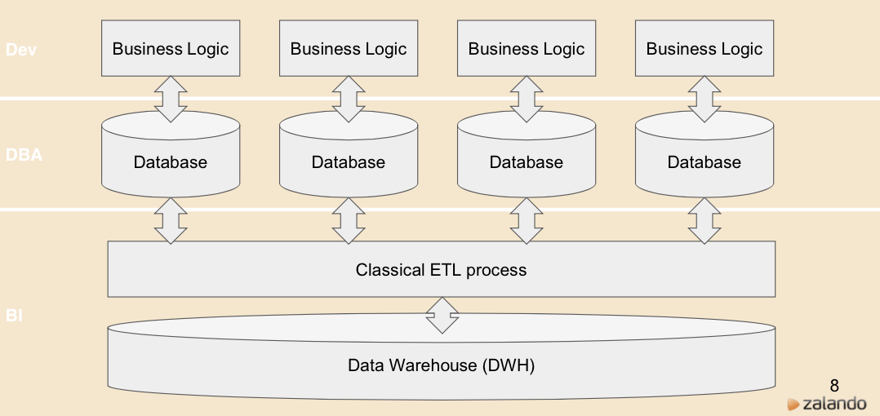
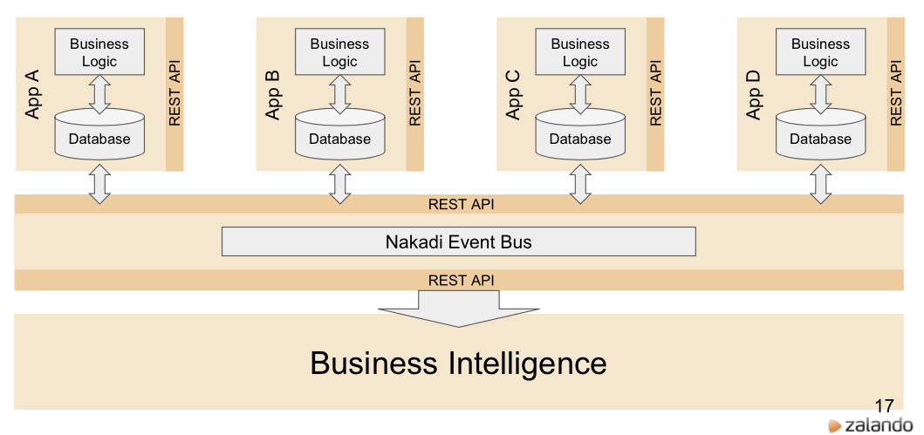
Zalando
Transitioning from monolithic
architecture to microservices

Slide 26
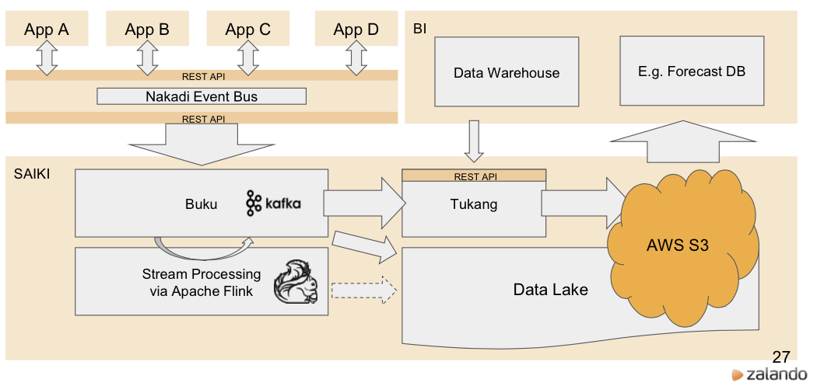
New BI stack

Slide 27
Flink @ Zalando (present & future)
Business process monitoring
Check if Zalando platform works
Order & delivery velocities
SLAs of related events
Continuous ETL
Transformation, combination, pre-aggregation
Data cleansing and validation
Complex Event Processing
Sales monitoring

Slide 28
Consolidate analytics

Slide 29
Stream Processing as a Service
How do we make stream processing more accessible to the data analyst?
More familiar interfaces
Flink 1.1 includes the first version of SQL for static data sets and data streams
Easier deployment

Slide 30


King.com

Slide 31
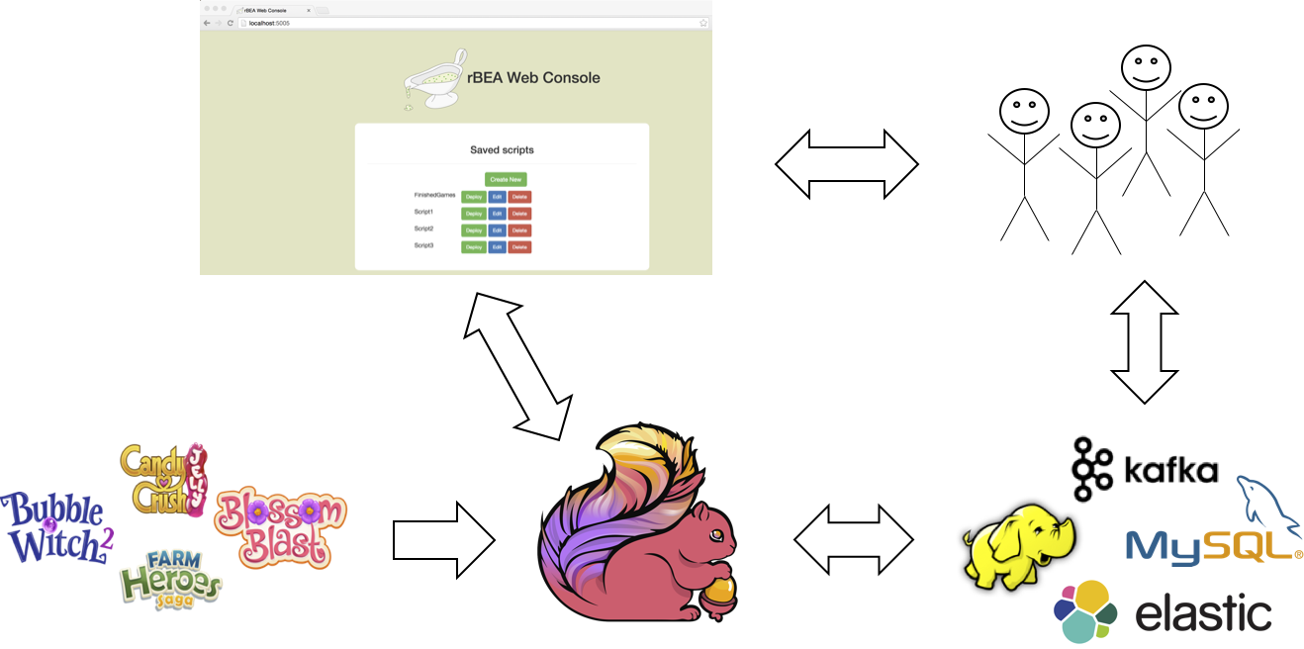
King.com - RBEA
RBEA – a platform designed to make stream processing available inside King.com
Data scientists submit scripts in Groovy
Flink backend executes these scripts
https://techblog.king.com/rbea-scalable-real-time-analytics-king/

Slide 32

Netflix
Netflix plans to offer Stream Processing as a Service internally in the company
Currently testing Flink and Apache Beam
http://www.slideshare.net/mdaxini/netflix-keystone-streaming-data-pipeline-scale-in-the-clouddbtb2016-62076009

Slide 33
Closing

Slide 34
Disclaimer
A lot of this presentation is based on the work of very talented engineers building data products with Flink
Special thanks to:
Amine Abdessemed (Bouygues Telecom)
Mihail Vieru, Javier Lopez (Zalando)
Gyula Fora, Mattias Andersson (King.com)
Monal Daxini (Netflix)

Slide 35


More Flink tales at Hadoop Summit
Xiaowei Jiang
Blink−Improved Runtime for Flink and its Application in Alibaba Search
Wednesday, June 29, 2016, 2:10PM - 2:50PM
210C
Stephan Ewen
Turning the Stream Processor into a Database: Building Online Applications on Streams
Thursday, June 30, 2016, 12:20PM - 1:00PM
212

Slide 36

Flink Forward 2016, Berlin
Submission deadline: June 30, 2016 (watch website)
Early bird deadline: July 15, 2016
www.flink-forward.org

Slide 37

We are hiring!
data-artisans.com/careers

